Slide 1

GEOLOGY
geology and its branches

Slide 2

Geology
Study about earth (origin, structure, inhabitants).

Slide 3
Branches of geology
Physical geology.
Structural geology.
Mineralogy.
Petrology.

Slide 4
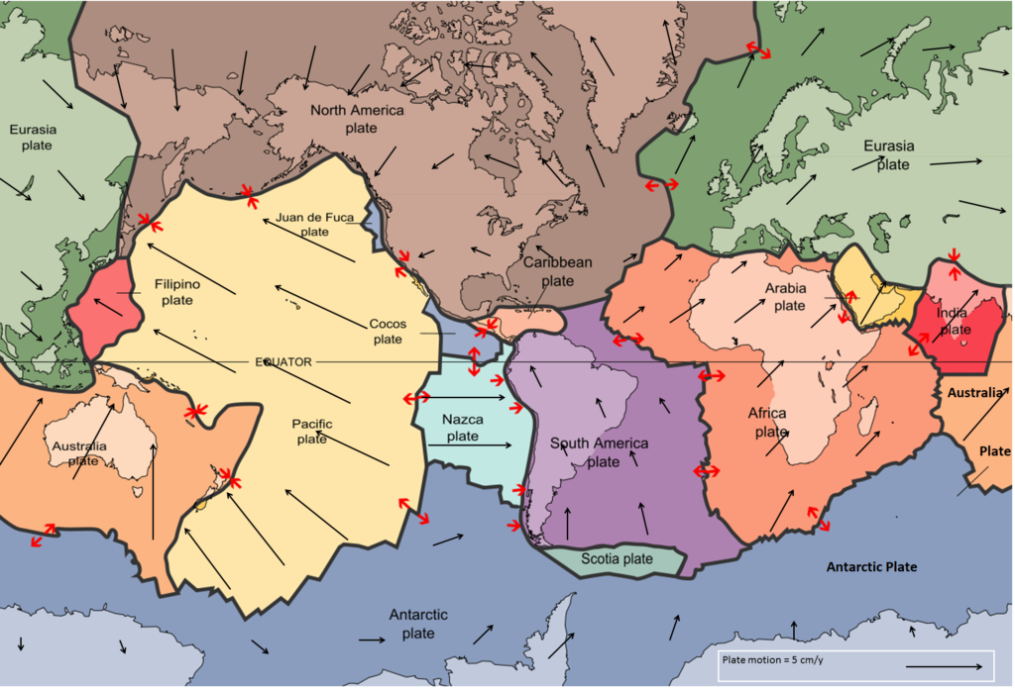
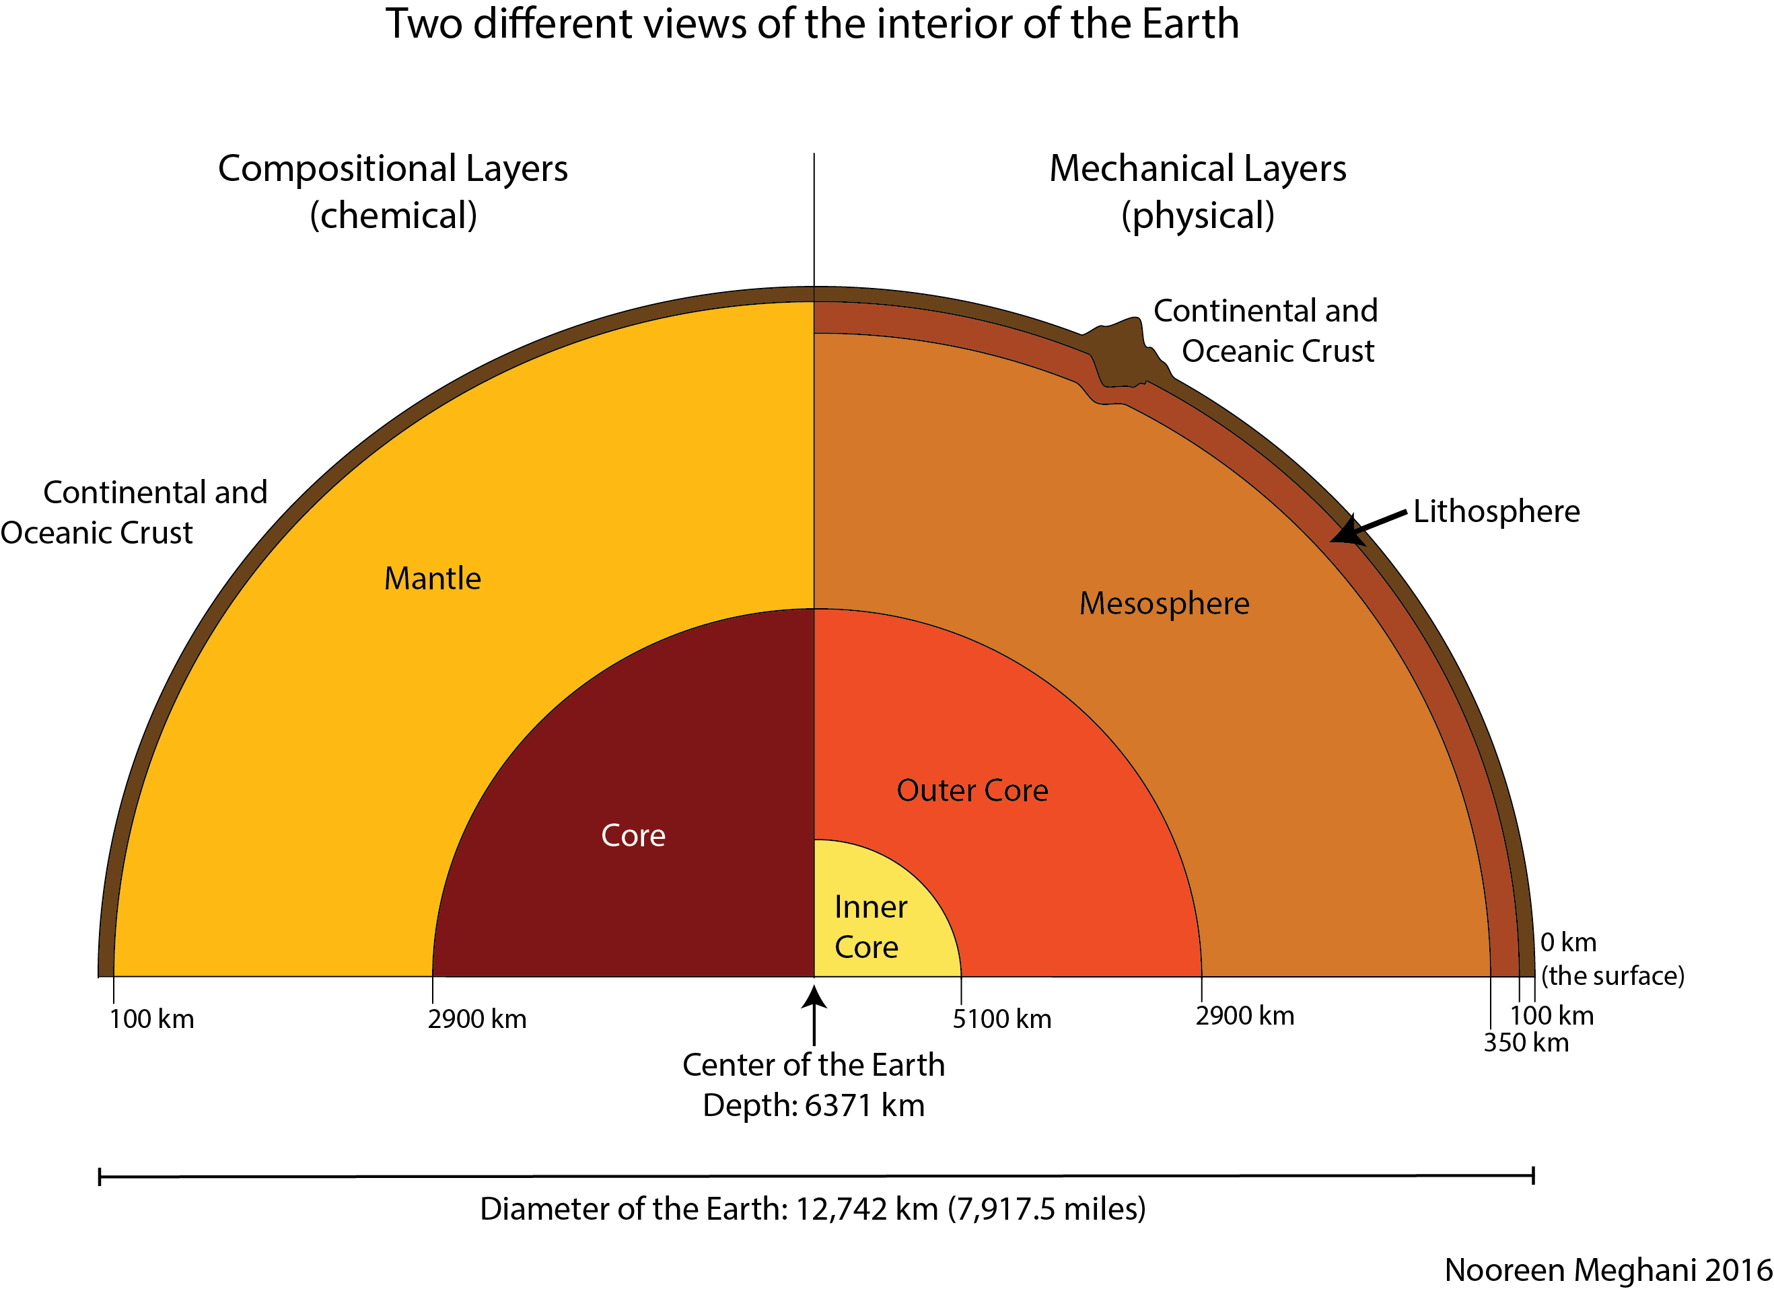
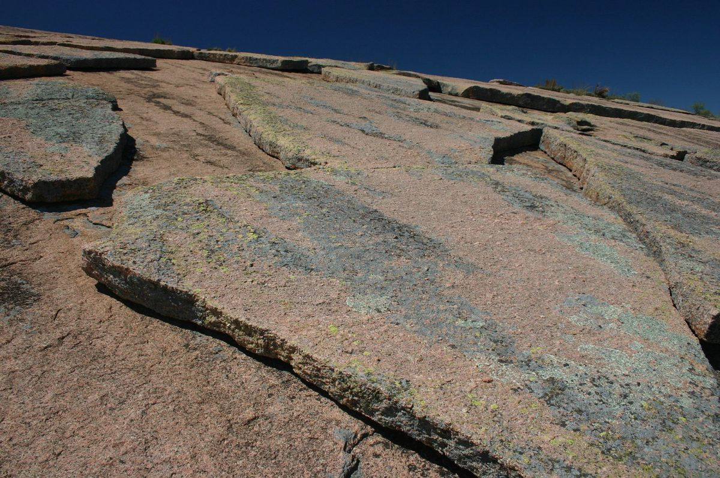
Physical geology
Study about natural processes which bring about changes on earth surface(earth quake, plate tectonics).

Slide 5
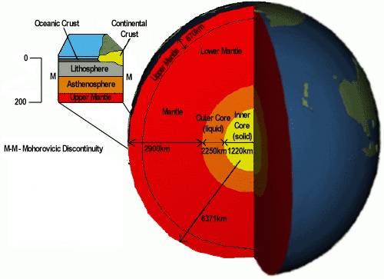
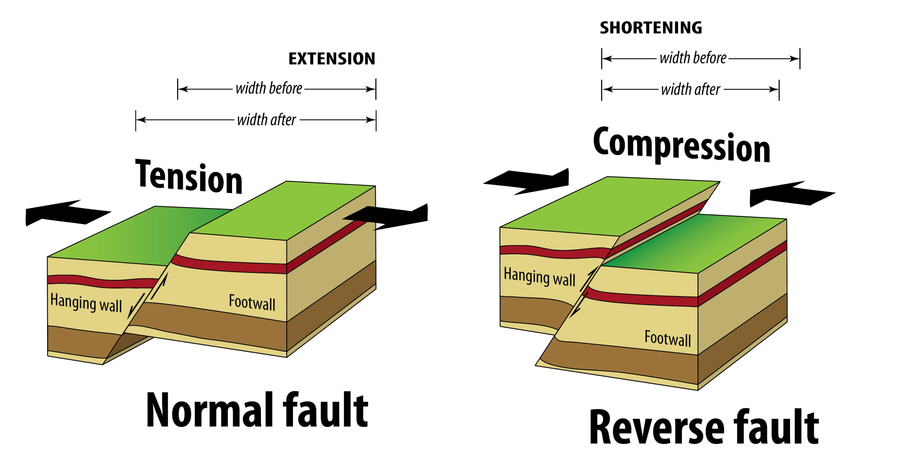
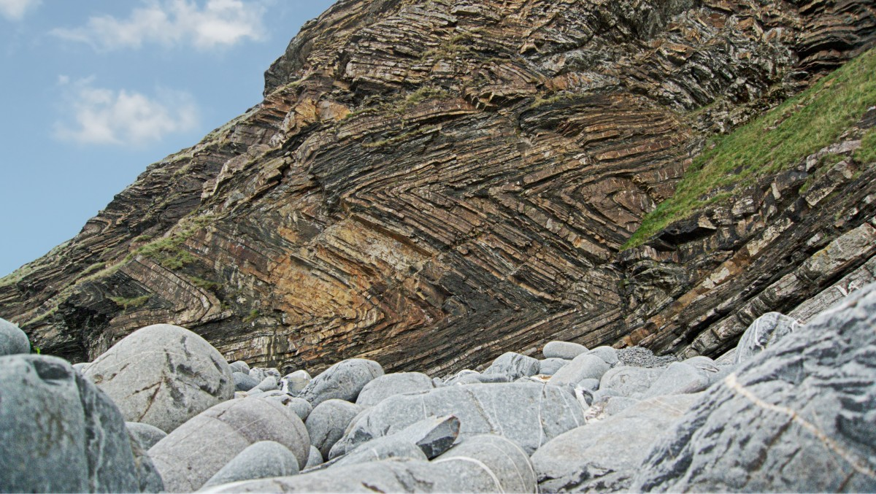
Structural geology
Study about rocks present on earth crust.

Slide 6
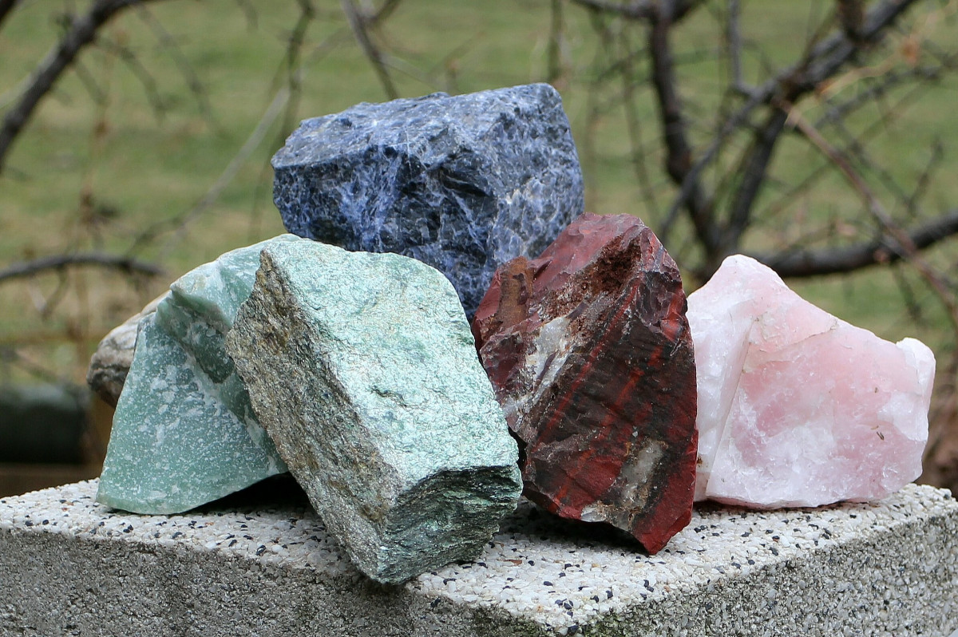
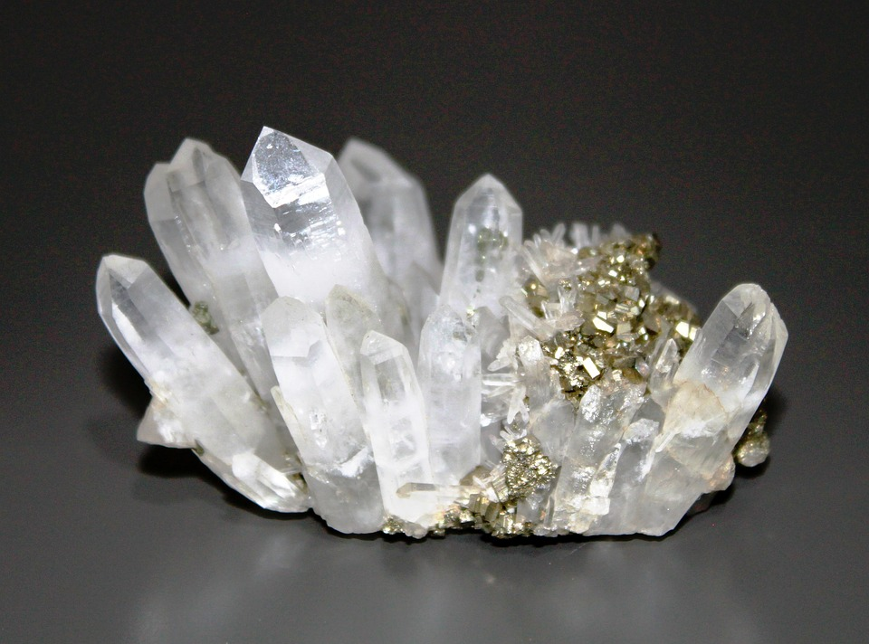
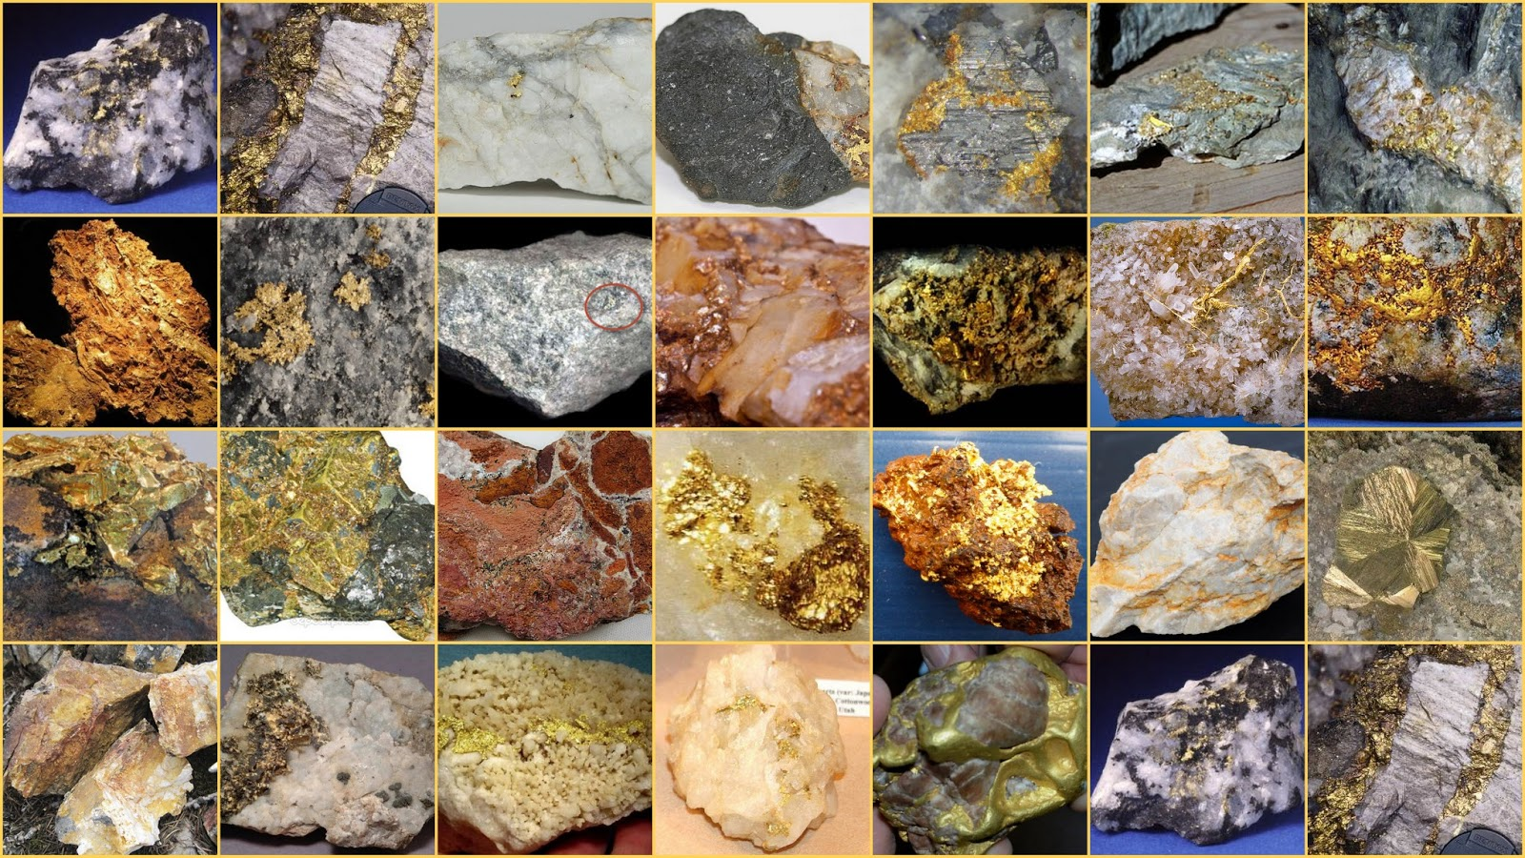
Mineralogy
Study about minerals(composition, occurance, properties, etc)

Slide 7
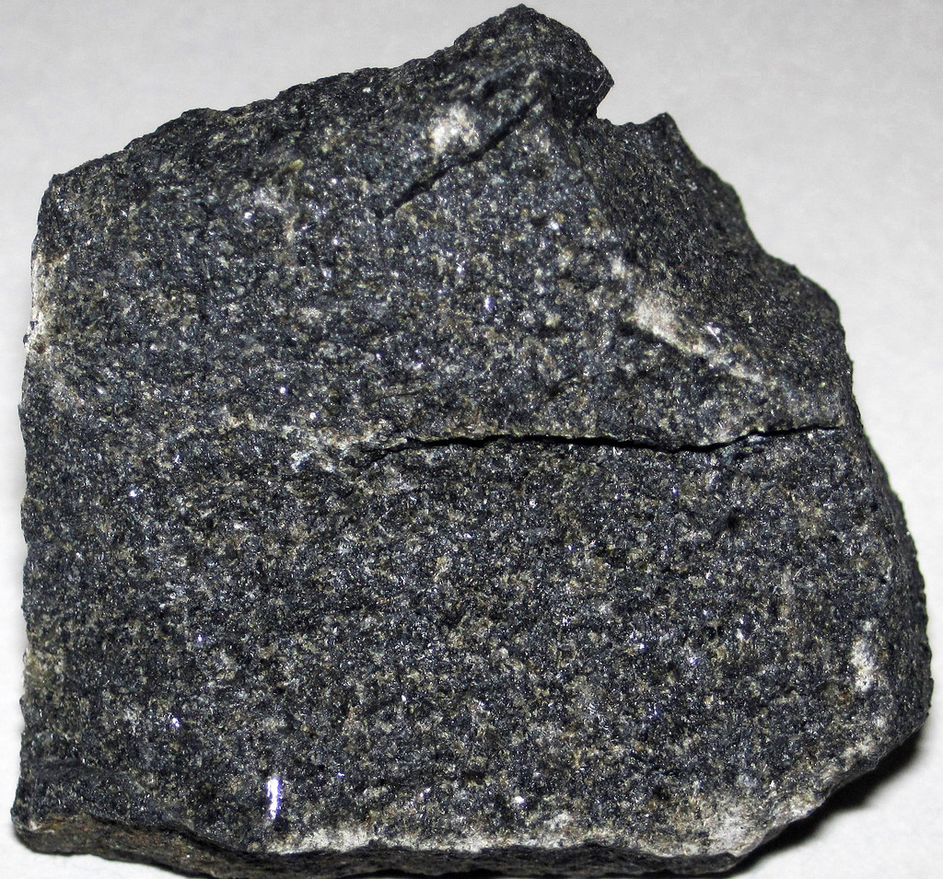
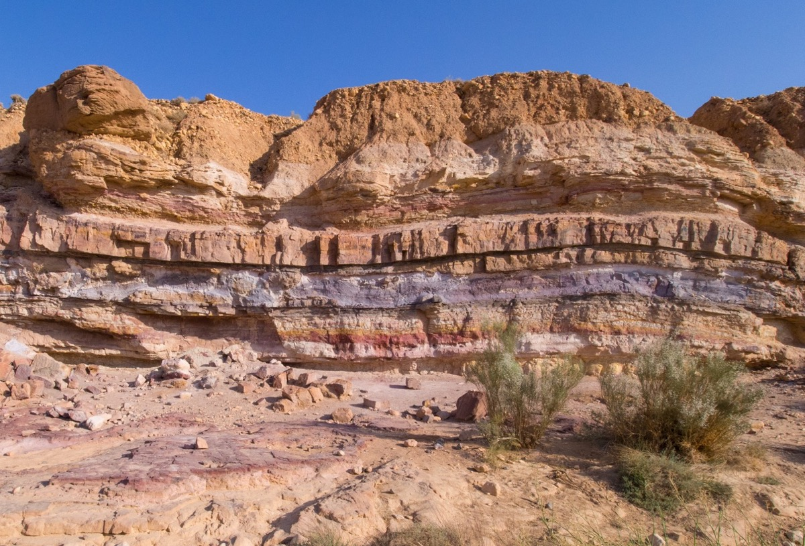
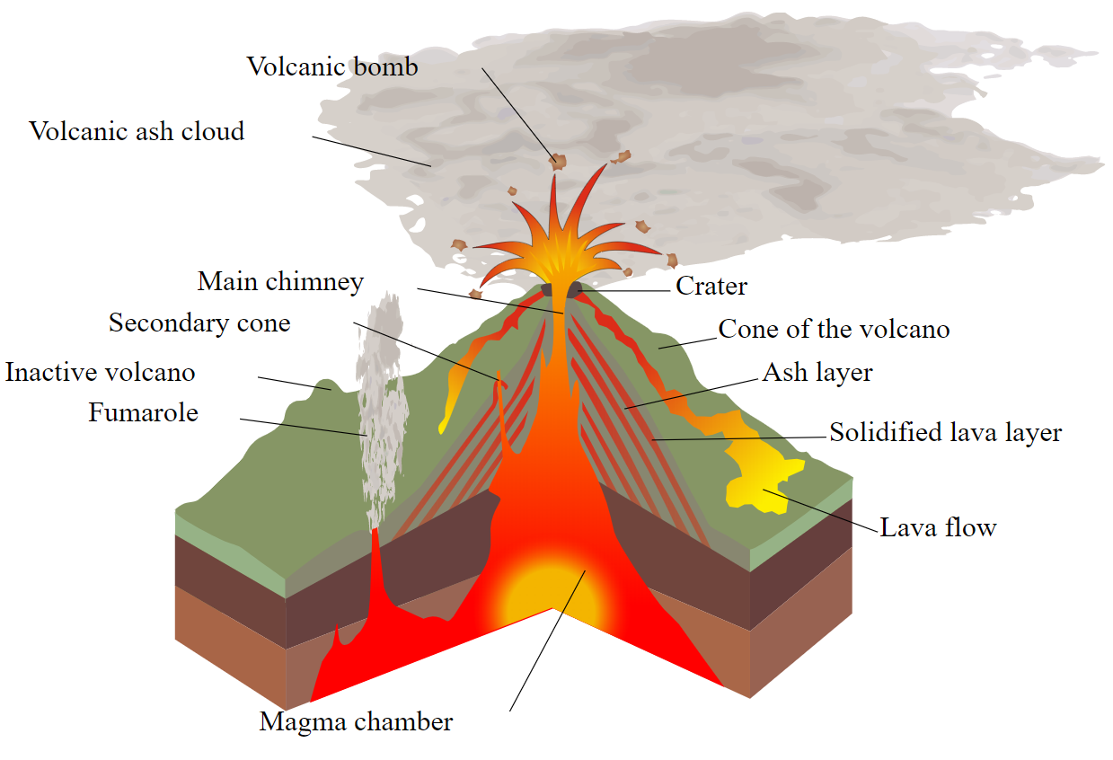
Petrology
Study about different kind of rocks(igneous, metamorphic, sedimentary rocks).

